Slide 1
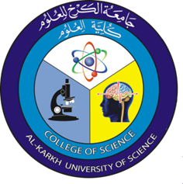
Cell Biology
Lecture 1
Second Level – First semester / 2020 – 2021
Dr. Asmaa Sami Ibrahim
Ph.D. Cytogenetic and Biology of fish

Slide 2
Syllabus Content
Lec. No. | Subject
1 | Introduction of the cell (Structure and function of the cell)
2 | Prokaryotes
3 | Eukaryote
4 | The cell membrane
5 | Types of Cell Transport
6 | Cell junctions and extracellular matrix
7 | Mid Exam
8 | The Cell Cycle
9 | Cancer cell
10 | DNA and Chromosomes
11 | DNA replication and proteins synthesis
12 | Cell respiration
13 | Cell signaling
14 | Cell death
15 | Final Exam

Slide 3
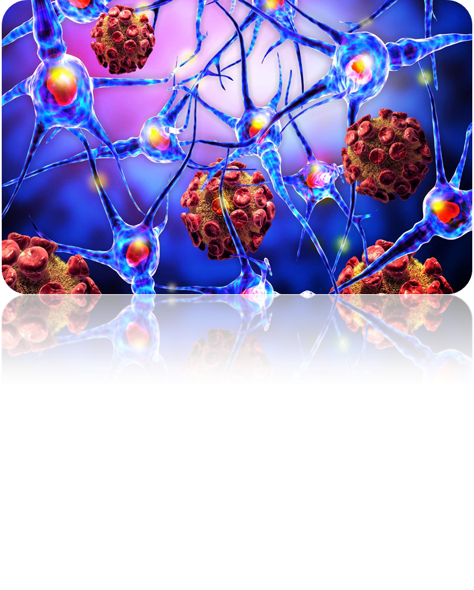
CELL BIOLOGY Lec ( 1 )
INTRODUCTION OF THE CELL
STRUCTURE AND FUNCTION
OF THE CELL

Slide 4
Introduction of the cell
Cell theory
Prokaryotes and Eukaryotes
Cell variability : - Cell size
- Cell shape
Internal organization
Function of cells

Slide 5
Cell Biology
* Both living and non-living things are composed of molecules made from chemical elements such as Carbon, Hydrogen, Oxygen, and Nitrogen. The organization of these molecules into cells is one feature that distinguishes living things from all other matter.
* Before the C17th, no one knew that cells existed, since they are too small to be seen with the naked eye. The invention of the microscope enabled Robert Hooke, (1665) to see and draw the first ‘cells’, a word coined by Hooke to describe the cells in a thin slice of cork.

Slide 6
Cell Biology
The cell is the smallest unit of matter that can carry on all the processes of life. Every living thing - from the tiniest bacterium to the largest whale - is made of one or more cells. The cell from Latin cella , meaning "small room".
* Cell is the basic structural, functional, and biological unit of all known living organisms, and is
often called the "building blocks of life".
* Cells consist of cytoplasm enclosed within a membrane, which contains many biomolecules such as proteins and nucleic acids.

Slide 7
Cell Biology
* The characteristics that allow a cell to perform there functions include:
1. A cell membrane that keeps the chemical reactions of life together.
2. At least one chromosome, composed of The genetic material that contains the important information of the cell.
3. Cytoplasm – the fluid inside the cell, in which the chemical processes of life occur.
Organisms can be classified as unicellular (consisting of a single cell; including bacteria) or multicellular (including plants and animals).

Slide 8
Cell theory
Cell Theory was eventually propose in 1838 by Matthias Schleiden and Theodor Schwann. However, many other scientists like Rudolf Virchow contributed to the theory and in 1855 ‘Cell Theory’ came – i.e. ‘cells only come from other cells’. This theory has become the foundation of modern biology.
Cell Theory consists of three principles:
1- All living organisms are composed of one or more cells.
2-The cell is the most basic unit of life.
3- All cells come only from the replication of existing, living cells.

Slide 9
Prokaryotes and Eukaryotes
Organisms whose cells normally contain a nucleus are called Eukaryotes; organisms whose cells lack a nucleus and have no membrane-bound organelles are known as Prokaryotes.
 | Prokaryotes | Eukaryotes
organisms | Bacteria, Blue-green algae | fungi, plants, animals
Typical size | ~1-10 µm | ~ 10-100 µm
Type of nucleus | Nuclear body, No nucleus | real nucleus with nuclear envelope
Ribosomes | 70S | 80S
Cytoplasmatic structure | very few structures | highly structured by membranes and a cytoskeleton
Organization | usually single cells | single cells, colonies, higher multicellular organisms with specialized cells
Cell division | Binary fission (simple division) | Mitosis (normal cell replication) Meiosis (gamete production)
DNA | Circular (usually) | Linear molecules (chromosomes)
Chromosomes | Single chromosome | More than one chromosome
Membranes | Cell membrane | Cell membrane and membrane- bound organelles

Slide 10
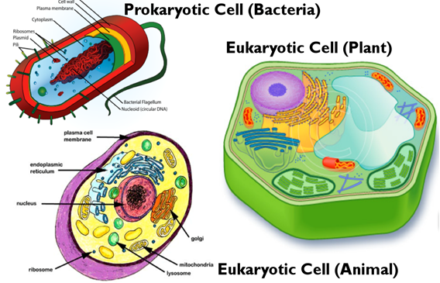

Slide 11
CELL VARIABILITY
Not all cells are similar. Even cells within the same organism show difference in size, shape, and internal organization.
CELL SIZE
A few types of cells are large enough to be seen by the eye ex chicken egg , where's most cells are small for two main reasons:
a). the ratio of nuclear material to the cytoplasm.
b). the ratio of the surface area to volume.
CELL SHAPE
Cells come in a variety of shapes – depending on their function ex.
Blood cells are rounded disks, so that they can flow smoothly.

Slide 12
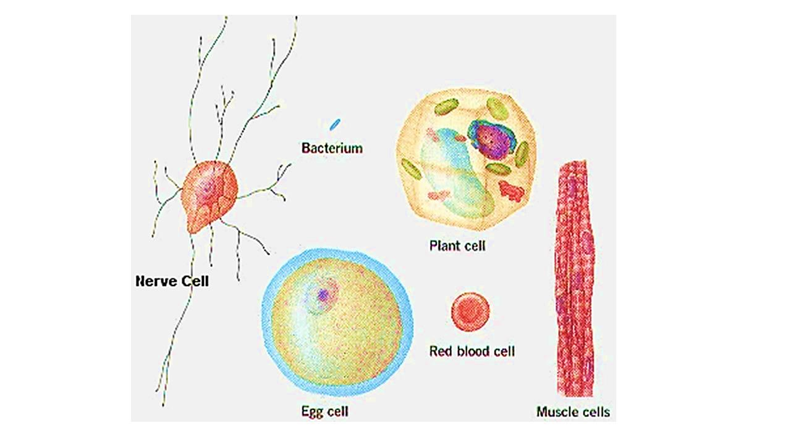

Slide 13
INTERNAL ORGANIZATION
1- Cells contain a variety of internal structures called organelles.
2- An organelle is a cell component that performs a specific function in that cell.
3- The organelles of a cell maintain the life of the cell.
4- There are many different cells; however, there are certain structures common to all cells. For example, The entire cell is surrounded by a thin cell membrane. All membranes have the same basic structure.
5- Organelles often have their own membranes too – once again, these membranes have a similar structure.
6- The nucleus , mitochondria and chloroplasts all have double membranes, more correctly called envelopes.

Slide 14
Function of Cells
Scientists define seven functions that must be preform by a living organism :
1. A living thing must respond to changes in its environment.
2. A living thing must grow and develop across its lifespan.
3. A living thing must be able to reproduce, or make copies of itself.
4. A living thing must have metabolism.
5. A living thing must maintain homeostasis, or keep its internal environment the same regardless of outside changes.
6. A living thing must be made of cells.
7. A living thing must pass on traits to its offspring.

Slide 15
Function of Cells
In biological terms, a cell’s main purpose is to survive – especially in the cases of single cell, so, although different types of cells generally have different specialized functions, some types of processes are common that all cells need to perform in order to survive. These include:
* Transport : Biochemical particles such as ions and molecules need to travel through the structures, e.g. tissues, of organisms to reach locations where they are needed. There are various transport mechanisms via which particles can travel.
* Chemical reactions: Metabolic processes including energy conversion.

Slide 16
Function of Cells
* Motility: in general motility can refer to movement of some components of the cell or to the movement of the whole cell.
* Reproduction ( Division ): transmission of genetic material from one generation to the next occurs via cell division. There are two types of cell division, mitosis and meiosis.

Slide 17
References:
Stephen R. B. , Jeremy S. H. , Elizabeth A. S. , Hugh A. W. & Claudia G. W. (2003).
CELL BIOLOGY (Second edition).
Harvey L. , Arnold B. , Paul M. , Chris A. K. , Monty K. , Matthew P. S. , Lawrence Z. & James D. ( 2003 ). Molecular Cell Biology (Fifth Edition ) .
Genetics Home Reference . (2019). Cells and DNA . https://ghr.nlm.nih.gov/, 19 pp.
Bianconi, E., Piovesan, A. , Facchin, F. , Beraudi, A. , Casadei, R. , Frabetti, F.,Vitale, L., Pelleri, M. C.& Tassani, S.(2013). "An estimation of the number of cells in the human body“, Annals of Human Biology, 40 (6): 463–471.
Milton H. S. Jr. & Stiles D.C. (2001). Introduction: Cell Structure and Function , Chapter 1 , 1-7pp.

